Slide 1
Week 3. Spatial Data
A. Michelle Lawing, PhD
Associate Professor
Paleobiology, Evolution, and Climate Lab
Ecology and Conservation Biology
Texas A&M University
alawing@tamu.edu

Slide 2
Welcome, hello, any announcements?

Slide 3
Class Plan
Today
  Overview of Project
  Spatial Data
  Overview of Lab 02
No class Thursday
Lab 02 due Friday before midnight
Project Topic due Friday before midnight
Read Peterson Chapter 4 and 5 for next Tuesday class preparation

Slide 4
Term Project
Ecological niche modeling analysis
  Develop an ecological question or problem
  Work with real or simulated occurrence and environmental data
  Build and evaluate one or more niche/distribution models
  Interpret results in an ecological context
  Develop a complete, reproducible workflow in R
60% of course grade

Slide 5
Project Milestones
Date | Milestone
Sept. 11 | Project topic
Oct. 2 | Data plan
Oct. 23 | Modeling plan
Nov. 6 | Preliminary results
Dec. 1 (redefined day) Dec. 10 1-3 pm (finals slot) | Presentation
Dec. 11 | Final paper

Slide 6
Project Strategy
Your project does not necessarily need to be complicated
A good project needs…
  a focused biological question
  a clearly defined and tractable study system
  data that are realistically obtainable (or a detailed plan for creating a simulated data set)
  a modeling approach that answers the question
  planned simulations to evaluate assumptions and understand how much confidence you can have to make inferences

Slide 7
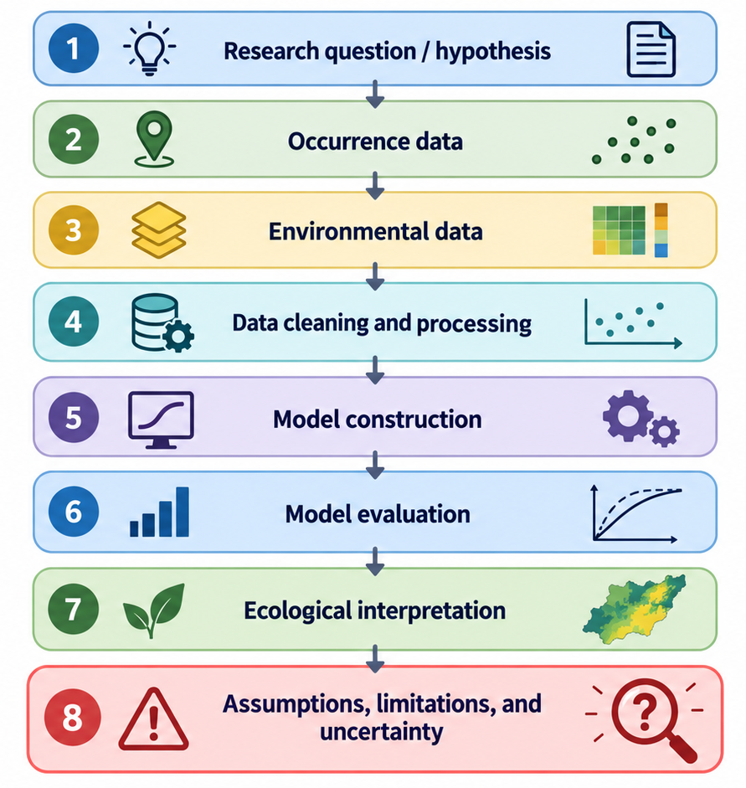

Slide 8
Project Topic Assignment
Purpose: to identify a preliminary topic for your term project.
Your project will develop throughout the semester, so you do not need to have the full analysis figured out yet.
Your question can be refined as you learn more about the data and modeling approaches available.

Slide 9
Submit a description of your project that includes:
Research question or idea — What are you interested in asking?
Study organism/system — What species, group, or system are you considering?
Geographic and/or temporal scope — Where and when would the project focus?
Biological motivation — Why is this question interesting or useful in ecological or conservation terms?
Questions or uncertainties — Identify anything you are currently unsure about or would like feedback on.

Slide 10
Submission template
Research question or idea:
Species/system:
Geographic/temporal scope:
Biological motivation:
Questions or uncertainties:
Format: PDF, up to 1 page, 12-point Times New Roman
Due: Friday, September 11 by 11:59 PM

Slide 11
More specific guidance
At this early stage, I am primarily looking for a focused, feasible topic and direction that can be developed over the semester.
A strong topic is generally:
  biologically motivated,
  narrow enough to complete this semester,
  connected to ecological niche or species distribution modeling,
  and likely to have occurrence and environmental data available or a feasible plan to simulate it.
You may refine or change your project topic as we work through data availability, scale, modeling assumptions, and feasibility.

Slide 12
R tools for the spatial workflow

Slide 13
Packages add specialized tools to R
Base R already contains many functions
A package is a bundle of functions, data, and documentation for a particular set of tasks
We load packages when we need tools that are not part of base R
Today…
  sf for spatial objects
  ggplot2 for plotting
  rnaturalearth for geographic data

Slide 14
Libraries and packages
# install once
install.packages("sf")
# load each new R session
library(sf)

Slide 15
Libraries and packages
# install once
install.packages("sf")
install.packages(c("sf", ”ggplot2", ”rnaturalearth"))
# load each new R session
library(sf)
library(ggplot2)
library(rnaturalearth)

Slide 16
Functions and data stored in packages
st_as_sf()
st_transform()
st_buffer()
functions usually take the form: function(input, arguments)
functions often return an object that we save:
world <- ne_countries(...)
a lot of learning R is learning what object you have, what function accepts that object, and what object comes back

Slide 17
Sourcing a script
source()
reads another R script
runs the whole script
recreates the objects produced by that analysis
source("analysis/01_occurrence_audit.R")

Slide 18
Throwing an error
exists()
stopifnot()
stopifnot(exists("occ_retained"))

Slide 19
Spatial objects in R
a regular data frame contains attributes
an sf object contains attributes (in a data frame), their associated geometry and a CRS

Slide 20
Convert to sf
st_as_sf()
occ_sf <- st_as_sf(
occ_retained,
coords = c("decimalLongitude", "decimalLatitude"),
crs = 4326,
remove = FALSE
)

Slide 21
Geographic vs projected coordinate reference systems
Geographic coordinates
  e.g., WGS 84 / EPSG:4326
  longitude and latitude
  units = degrees
  useful for describing geographic location
Projected CRS
  x and y coordinates
  often units = meters
  useful for distance, area, buffers

Slide 22
Projected CRS
st_transform()
occ_projected <- st_transform(occ_sf, 32614)

Slide 23
Reading Help Pages
?st_buffer
?geom_sf
When you open help, look for:
Usage — how is the function written?
Arguments — what does it need?
Value — what does it return?
Examples — how is it commonly used?

Slide 24
Lab 02

